Slide 1
Planting date strategies and risk: Towards greater economic benefits in rice-wheat systems in Bihar
Maxwell Mkondiwa
Anton Urfels
Others

Slide 2
Motivation
Advancing rice sowing date considered entry point for rice-wheat system optimization
Heterogeneity in returns to technology adoption and risk preferences have been proposed to affect lack of adoption of profitable innovations
See Hurley et al 2018, Suri 2011, Dercon

Slide 3
Related literature
Stability analyses of crop simulation results
Urfels et al (2022), Montes et al (2022)
Risk assessment of crop simulation results
Mean-variance analysis
Second order stochastic dominance and risk aversion: Hurley et al (2018)

Slide 4
Computational Models
Crop simulation model
Mean-variance optimization model???
Computational risk assessment model

Slide 5
Data and crop simulation models
Scenario number | Rice | Wheat | Description
S0 | Farmer practice | Farmer practice | Farmers’ practice baseline without nutrient and water limitations to understand current limits
S1 | Fixed long (baseline) | Fixed long (baseline) | Planting long duration variety at a fixed recommended date
S2 | Fixed medium | Fixed medium | Planting medium duration variety at a fixed recommended date
S3 | Onset long | Onset long | Planting long duration rice variety at the onset of monsoon
S4 | Onset long supp | Onset long supp | Supplementary irrigation for planting long duration varieties at monsoon onset
S5 | Onset medium | Onset medium
S6 | Onset medium supp | Onset medium supp | Supplementary irrigation for planting medium varieties at monsoon onset

Slide 6
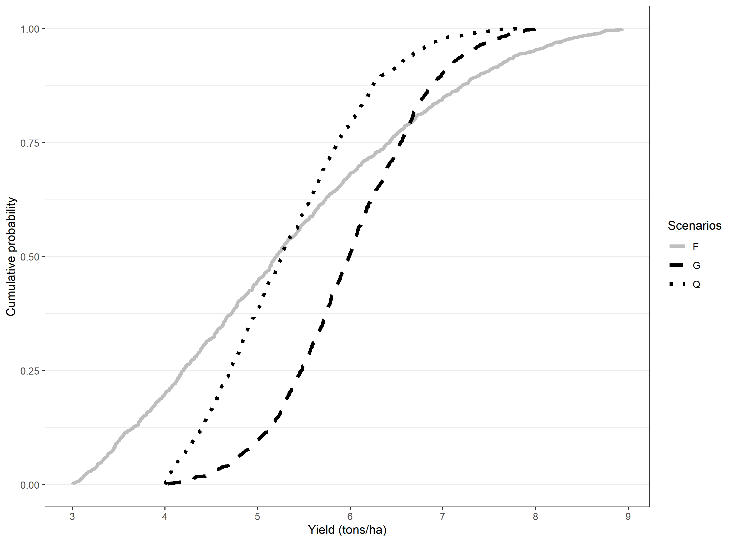
First and second order stochastic dominance
First order stochastic dominance
G first order stochastically dominates Q
FOSD implies SOSD
Second order stochastic dominance
Assuming same mean, agents prefer the technology with less outcome variance
Based on area of CDFs
G SOSD F
G= rtruncnorm,
n=1000
a=4
b=8,
mean=6,
sd=0.8),
Q=rtruncnorm
n=1000
a=4
b=8
mean=5
sd=1)
F=rtruncnorm
n=1000
a=3
b=9
mean=5
sd=2.

Slide 7
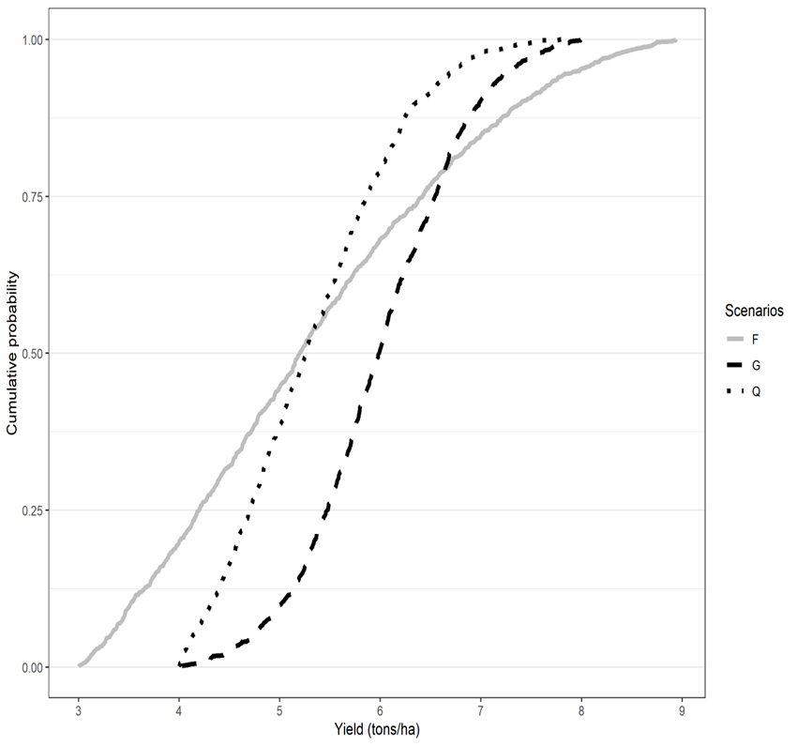
Computational spatial ex-ante economic model under risk aversion
 | G | Q | F | Q(base) vs G | Q vs F | F vs G
t | 1000 | 1000 | 1000
Min=a | 4 | 4 | 3
Max=b | 8 | 8 | 9
Mean | 6 | 5 | 5
SD | 0.8 | 1 | 2
Interpretation |  |  |  | G F/SOSD Dominate Q | Not clear | G SOSD Q
WTP Lower bound |  |  |  | 0.036 | 0 | 0.499
WTP Upper bound |  |  |  | 0.763 | 0.218 | 1.384

Slide 8
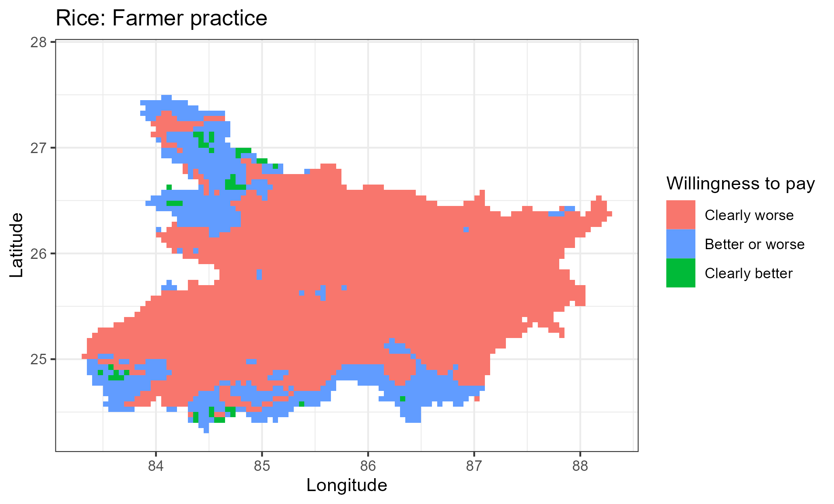
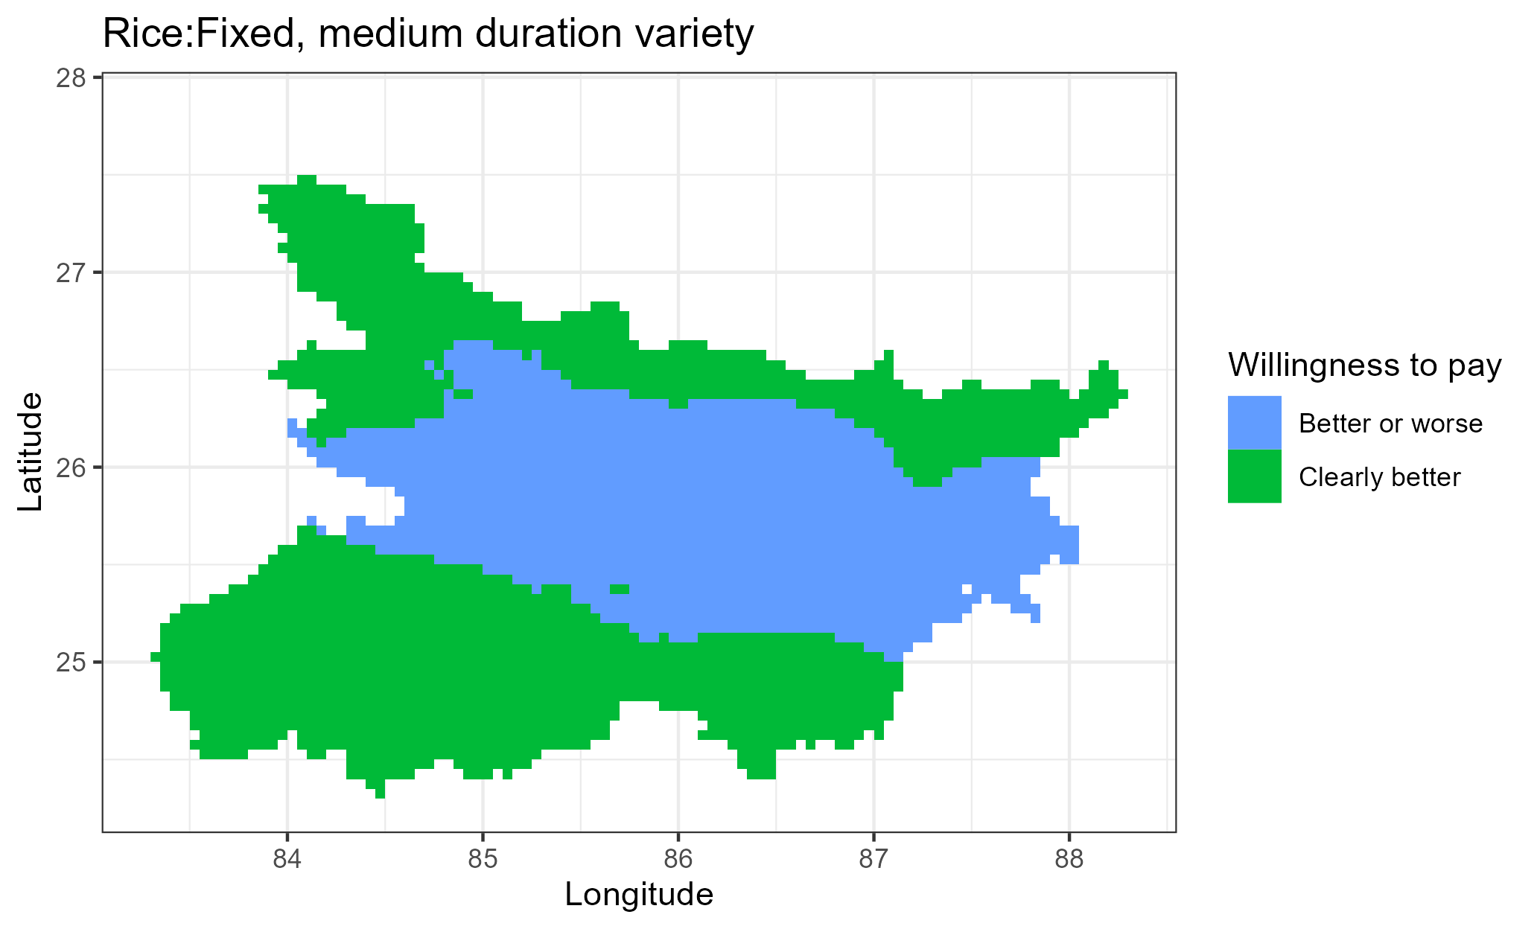
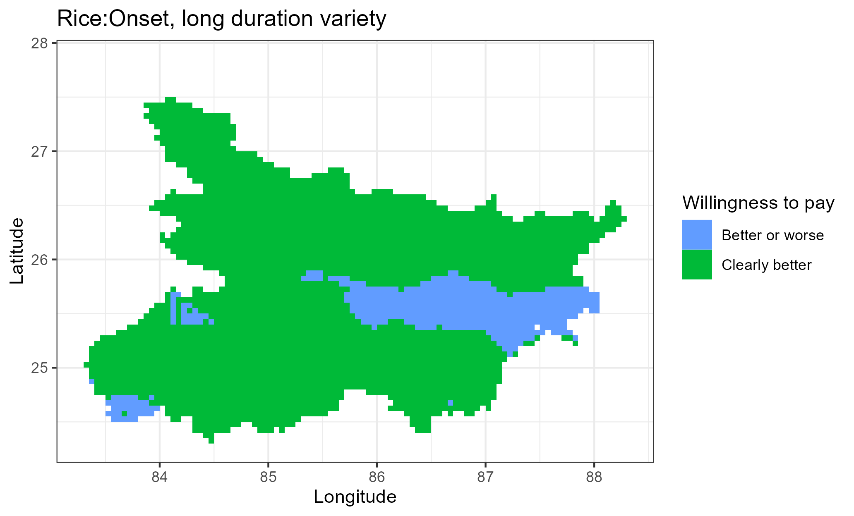
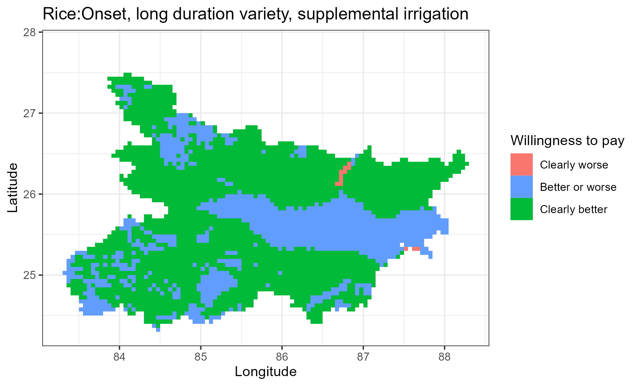
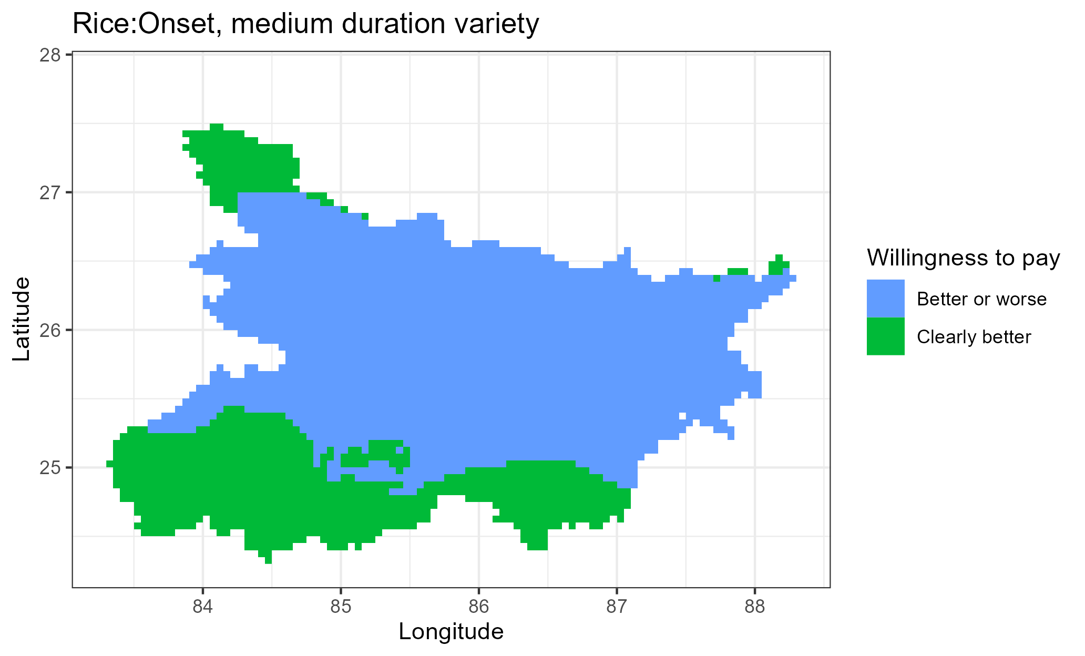

a
b
c
d
e
f

Slide 9
RICE

Slide 10
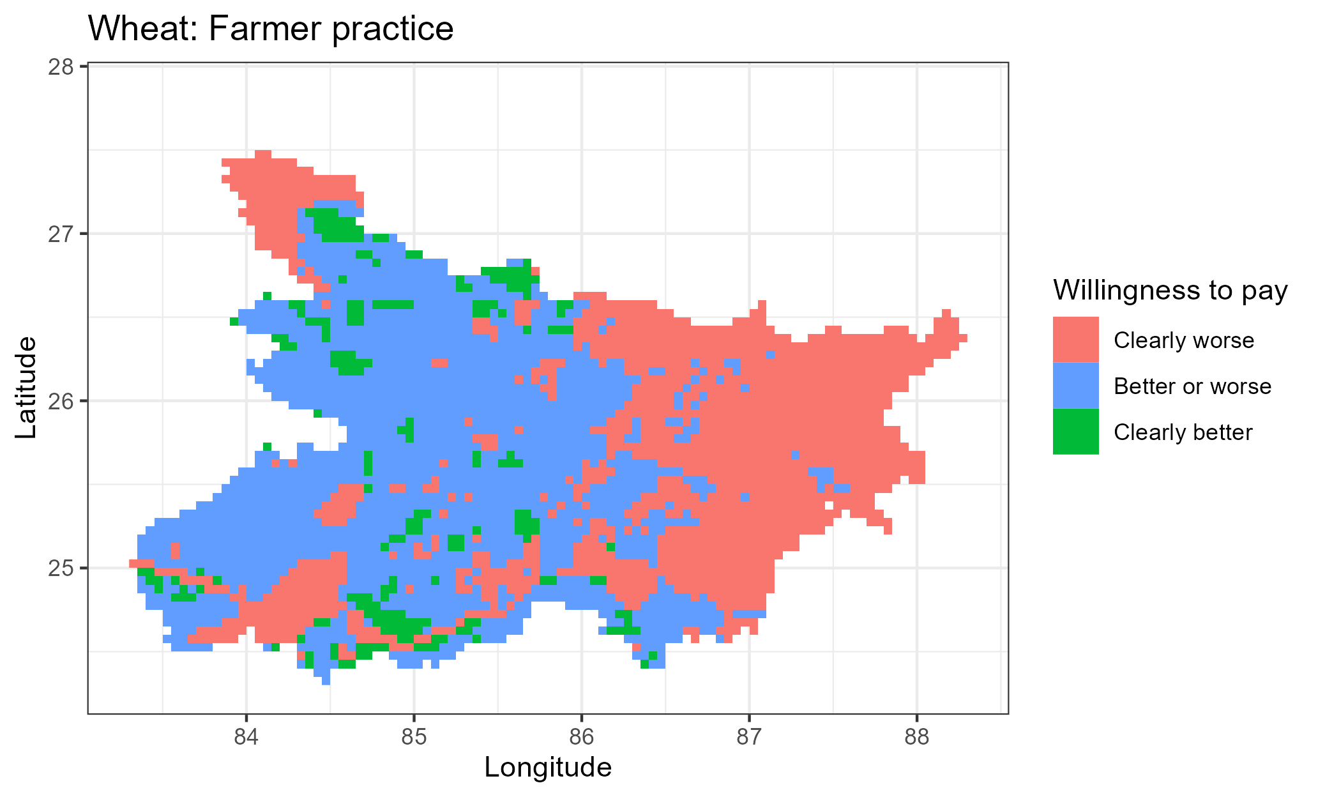
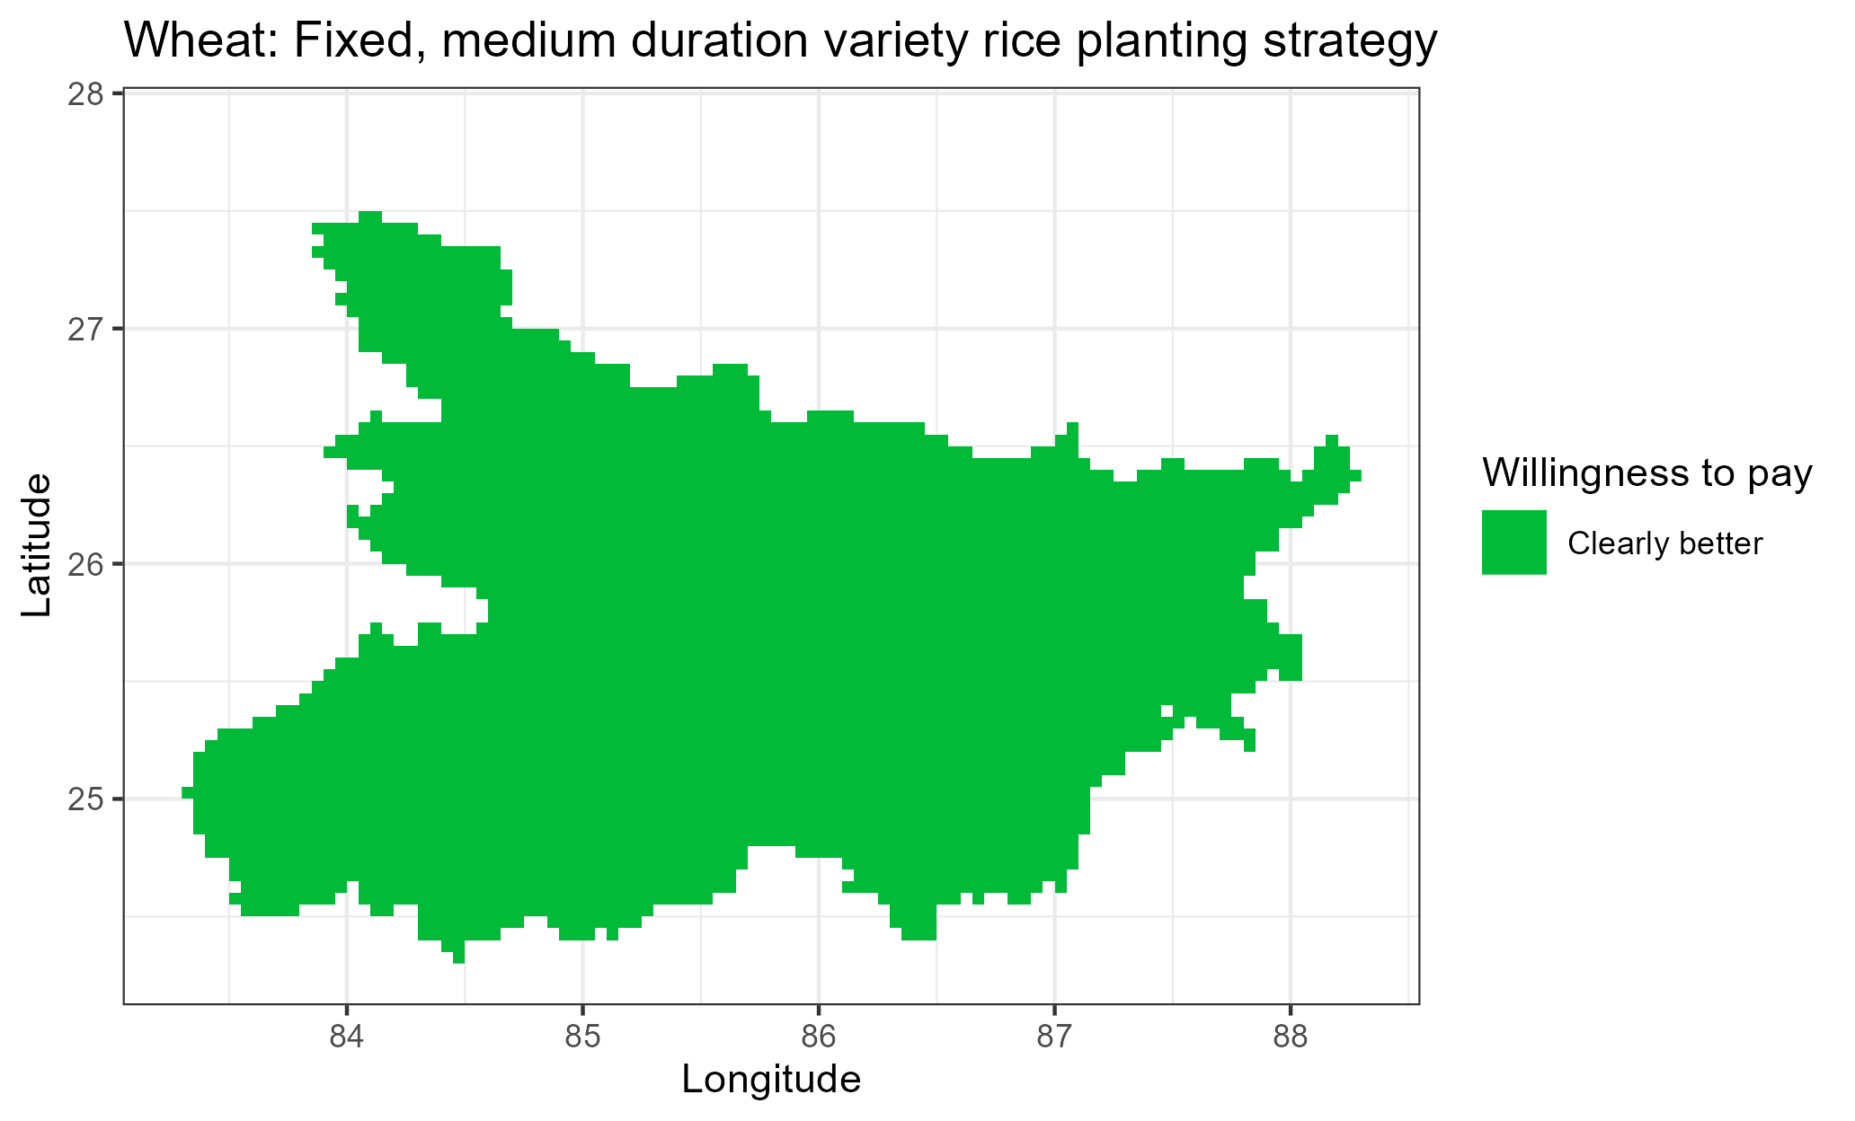

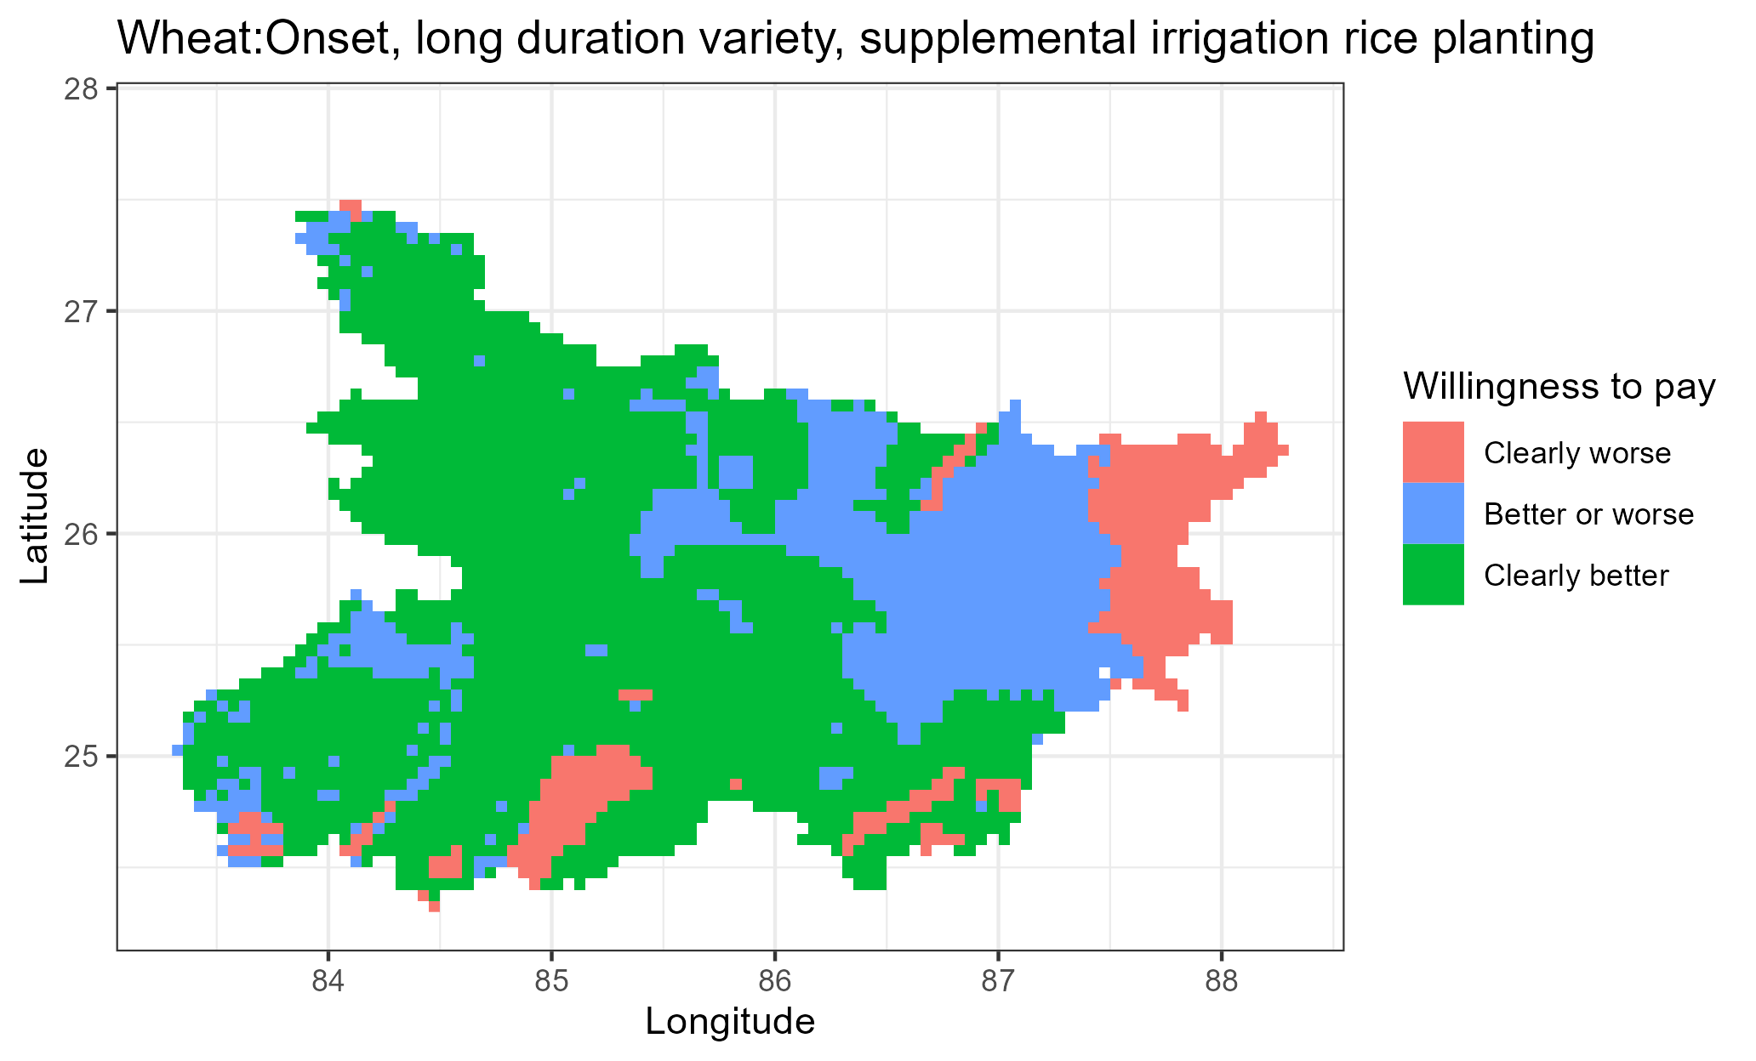
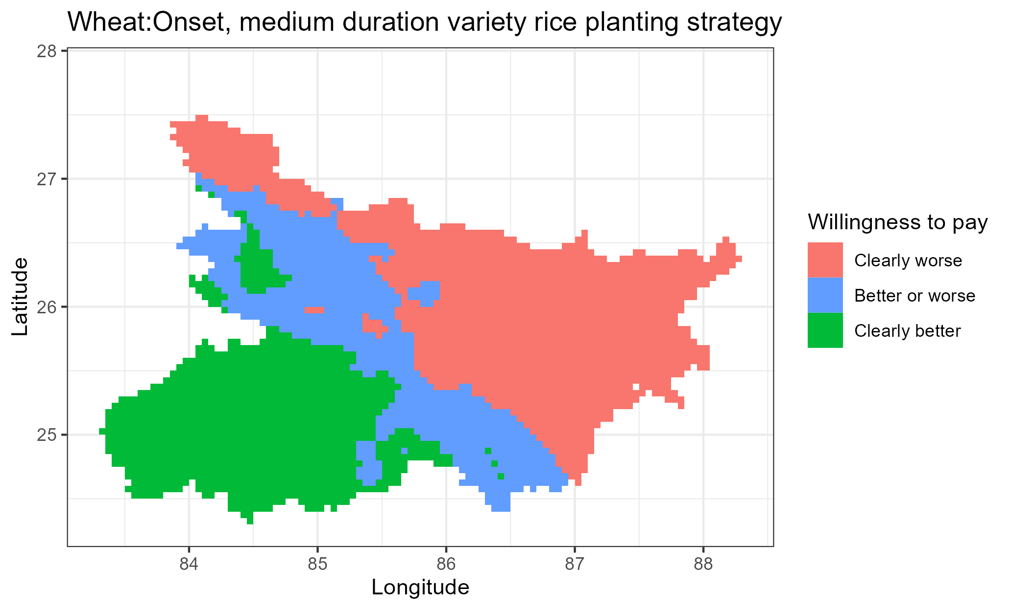
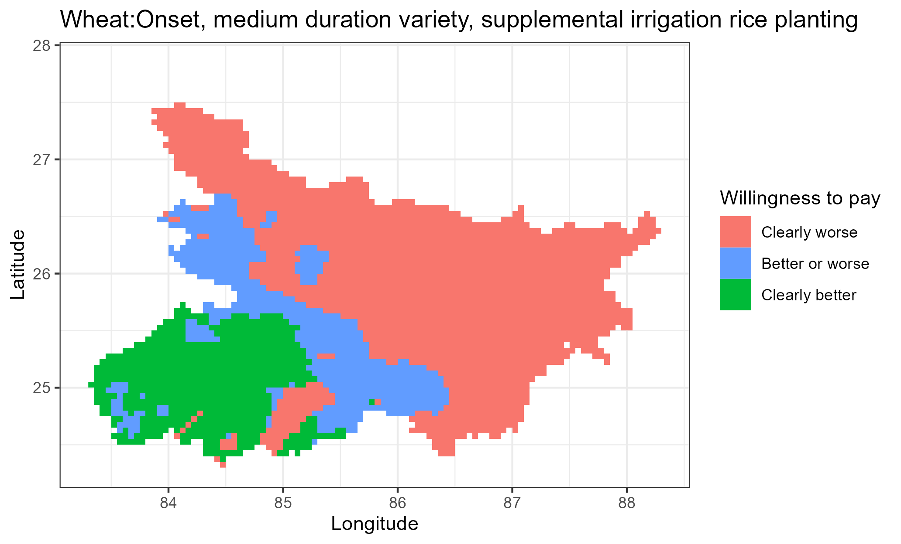
a
b
c
d
e
f

Slide 11
WHEAT

Slide 12
Economic assessment for each crop separately

Slide 13
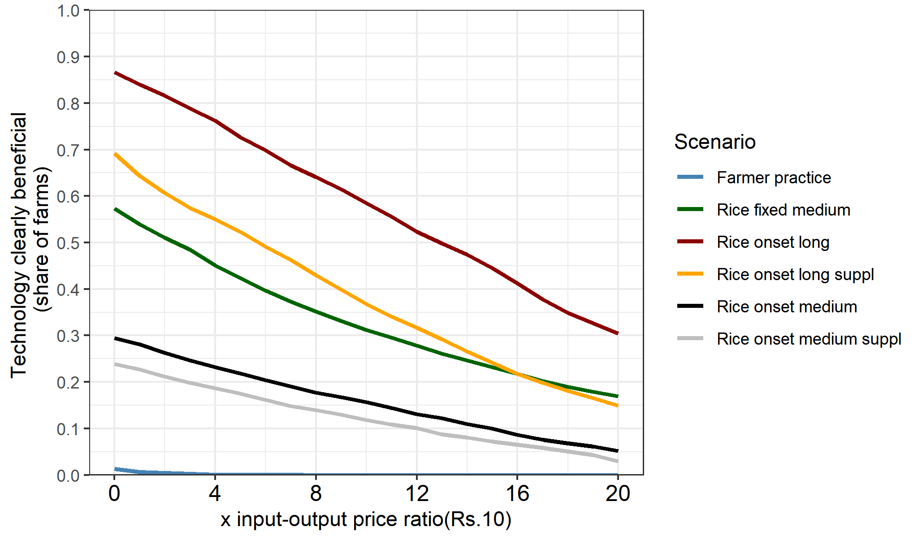
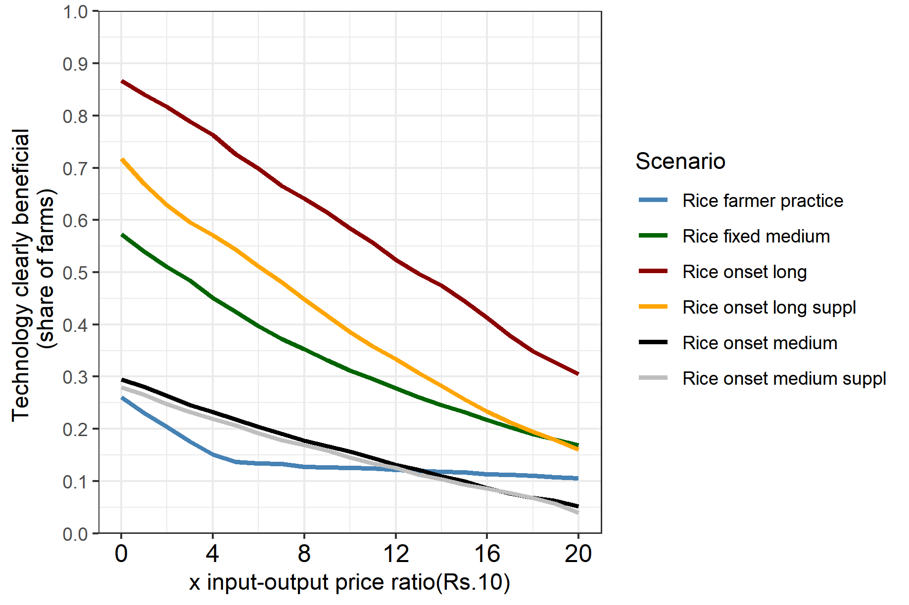
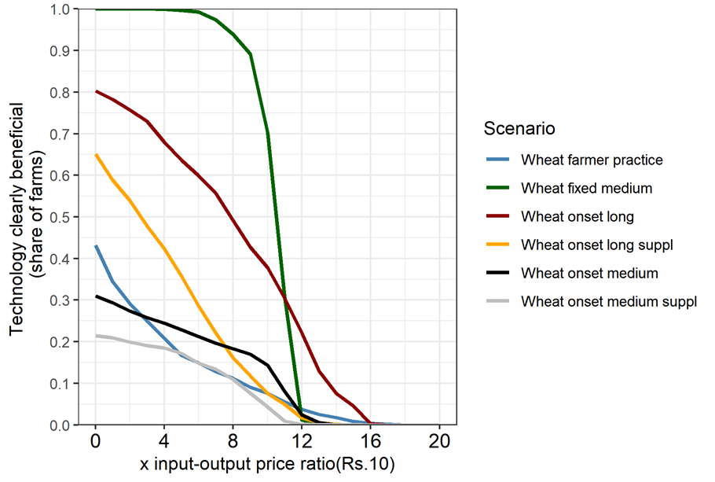
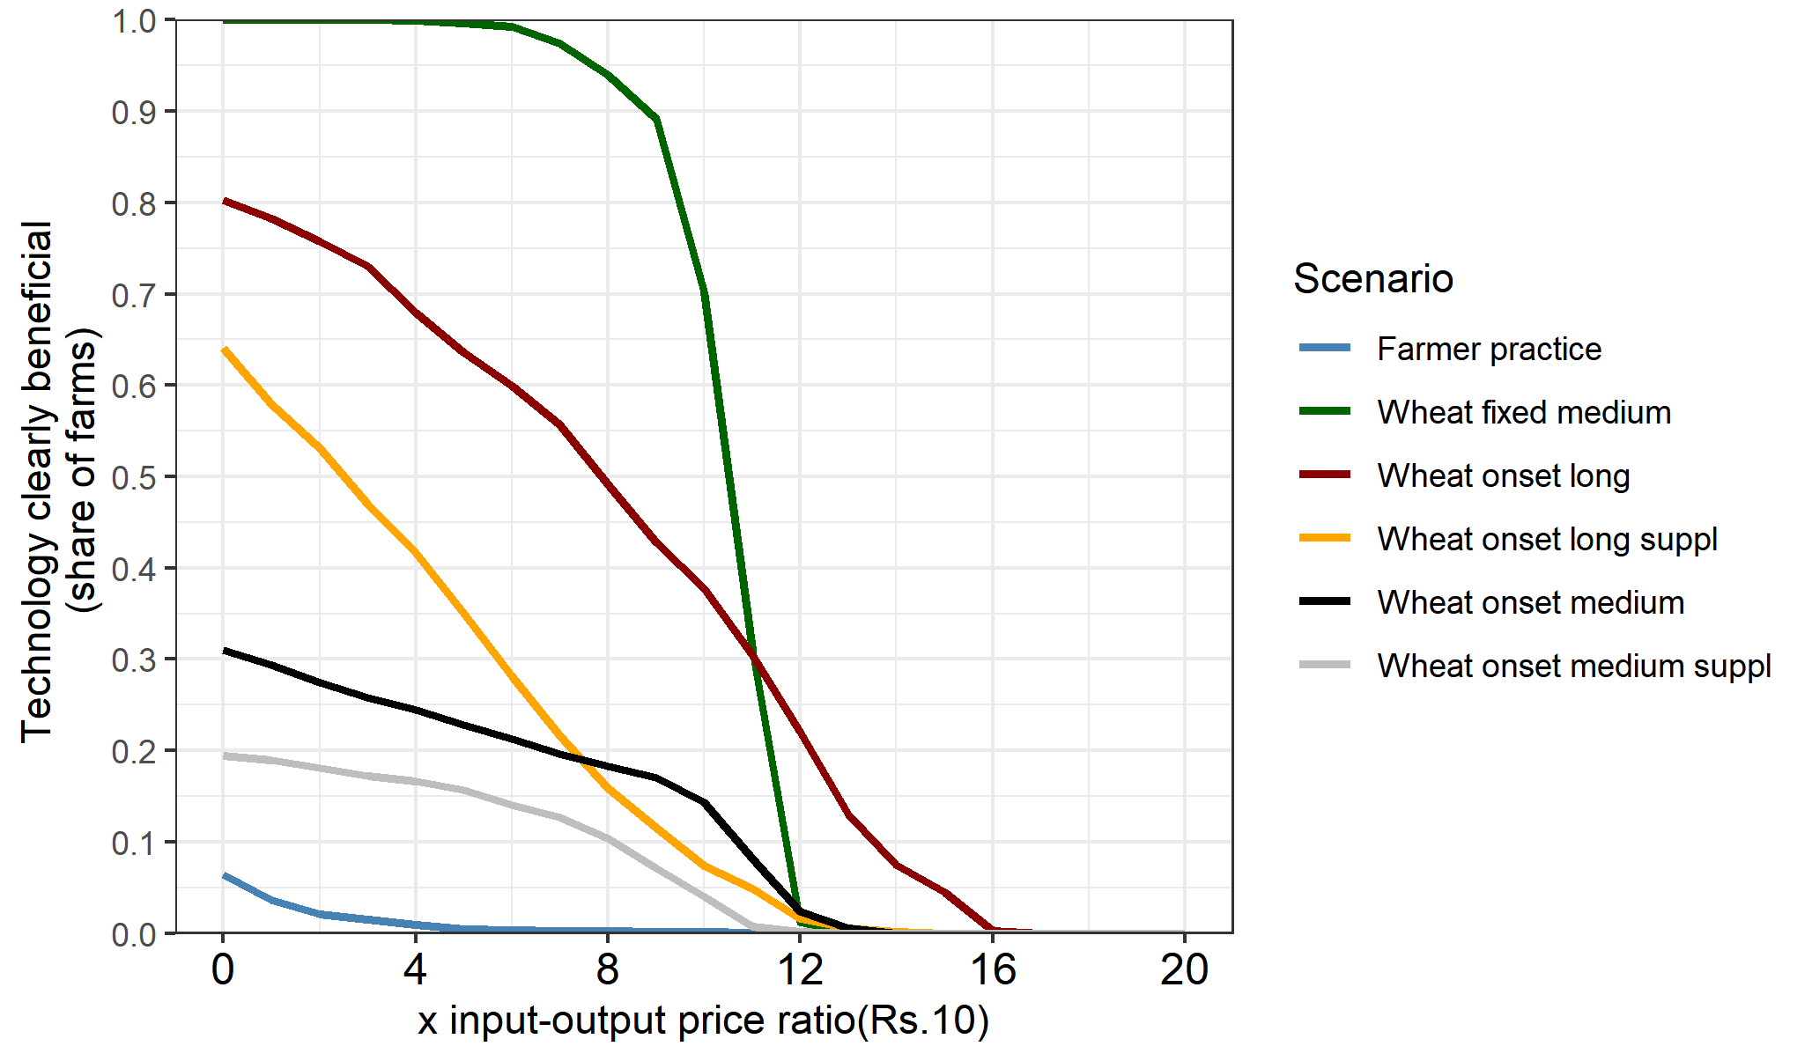
a. Without zero yield entries [fixed long as reference]
b. With zero yield entries [fixed long as reference]
Rice
Rice
Wheat
Wheat

Slide 14
Economic and risk assessment of cropping system

Slide 15
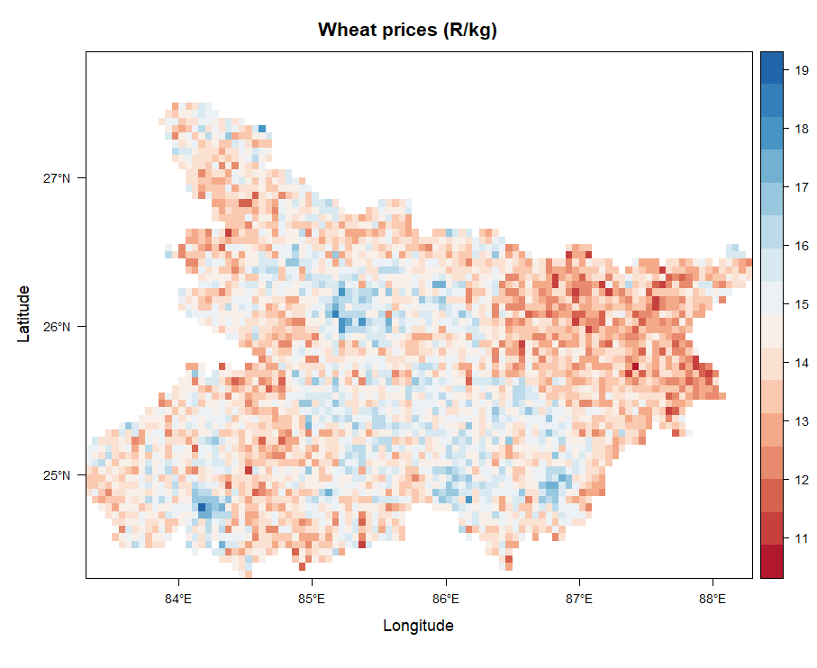
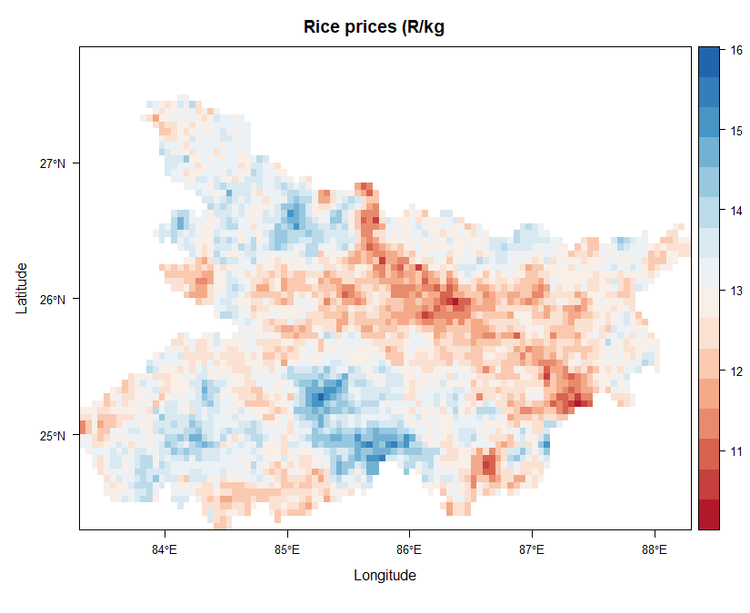
Interpolated rice and wheat prices

Slide 16
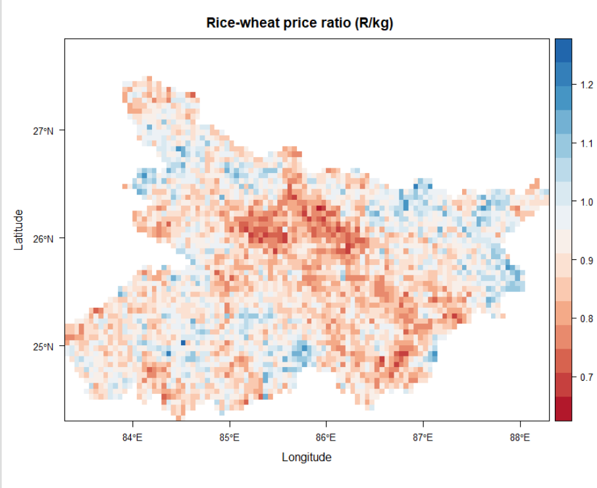

Slide 18

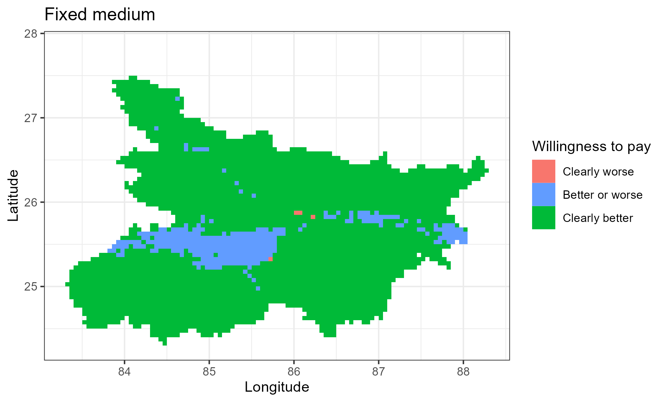
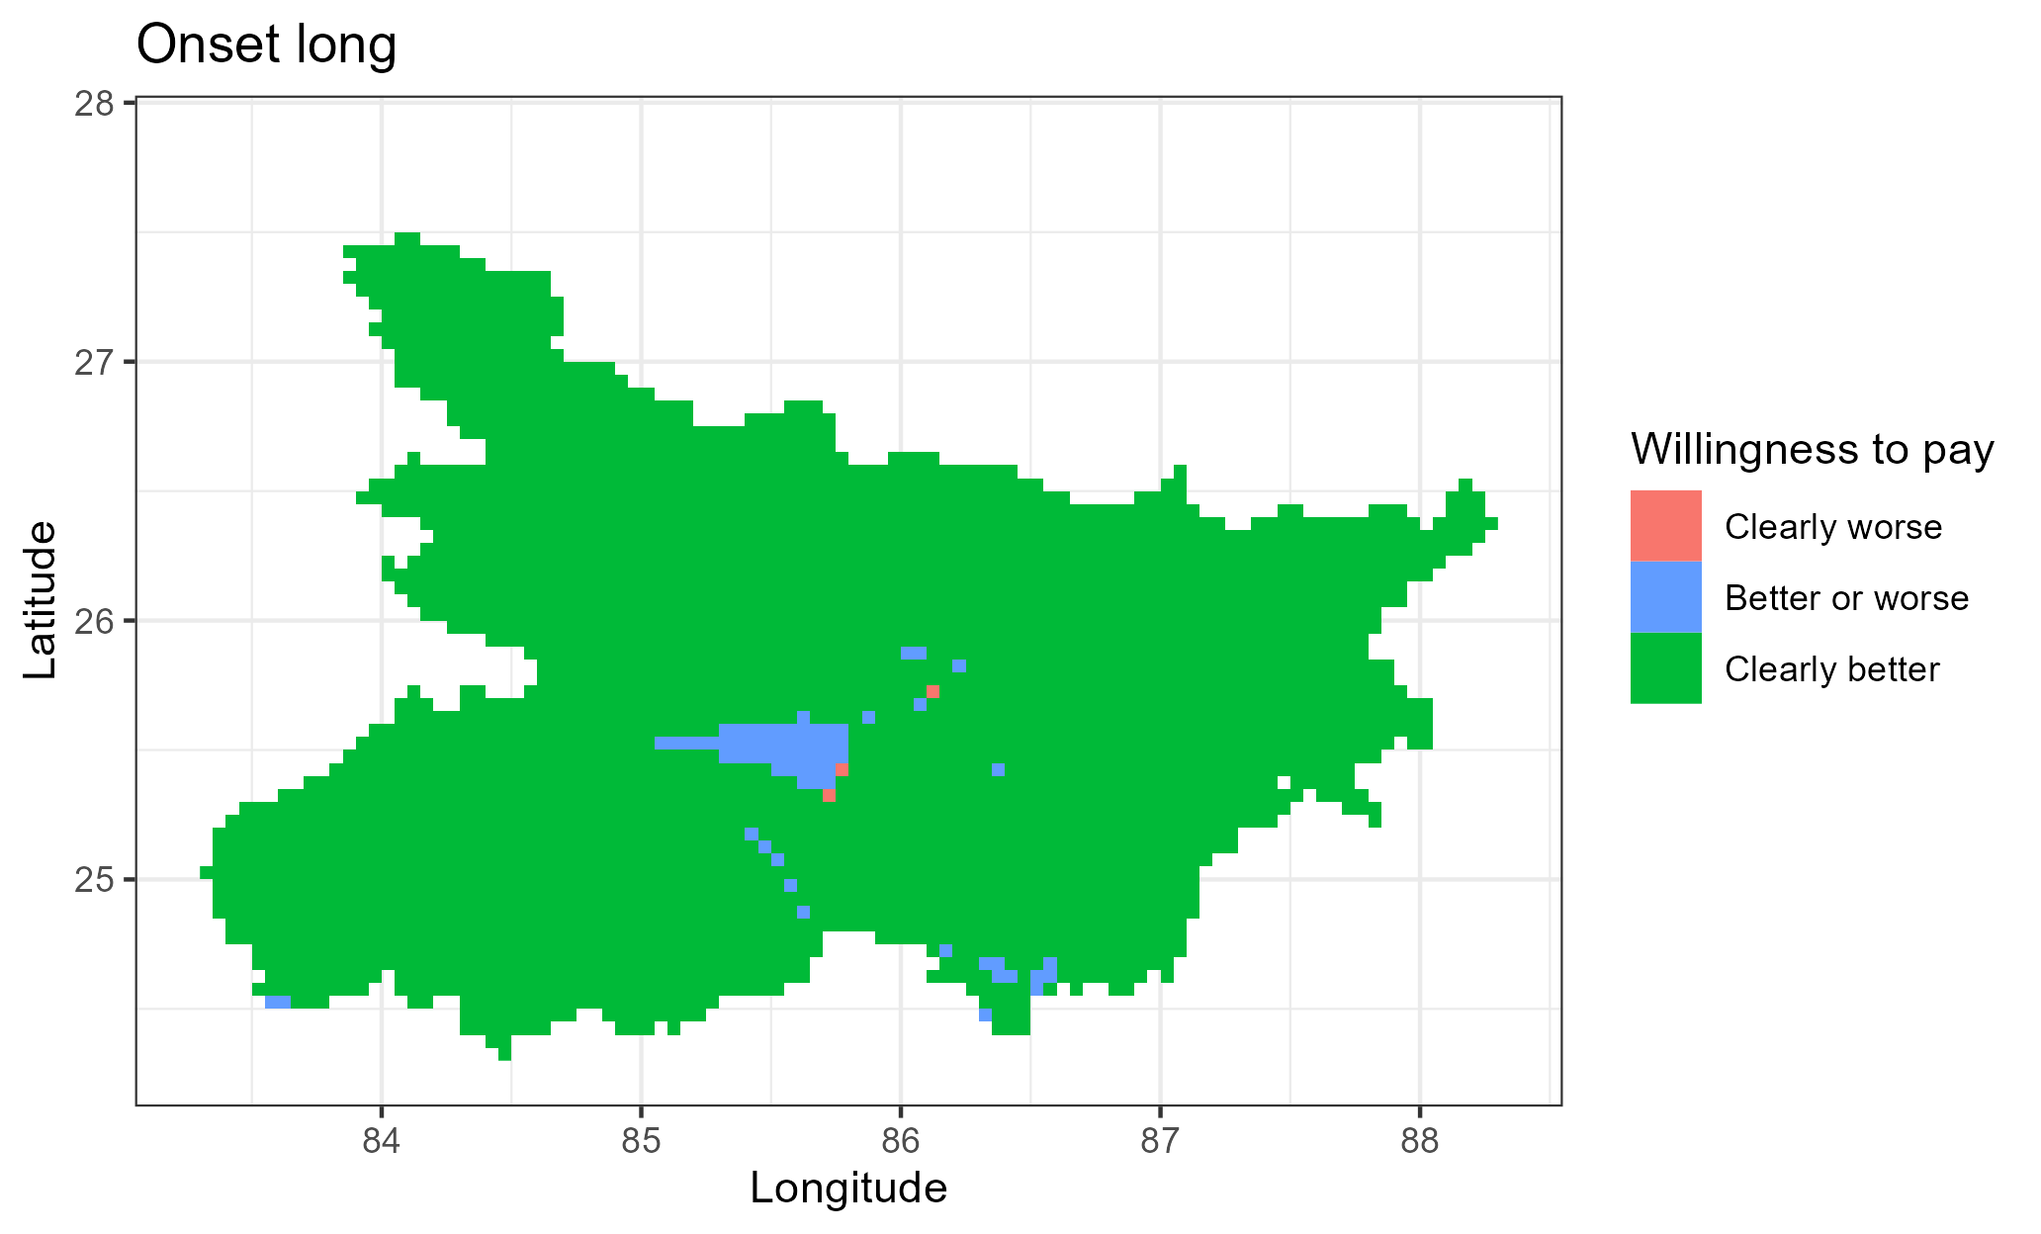
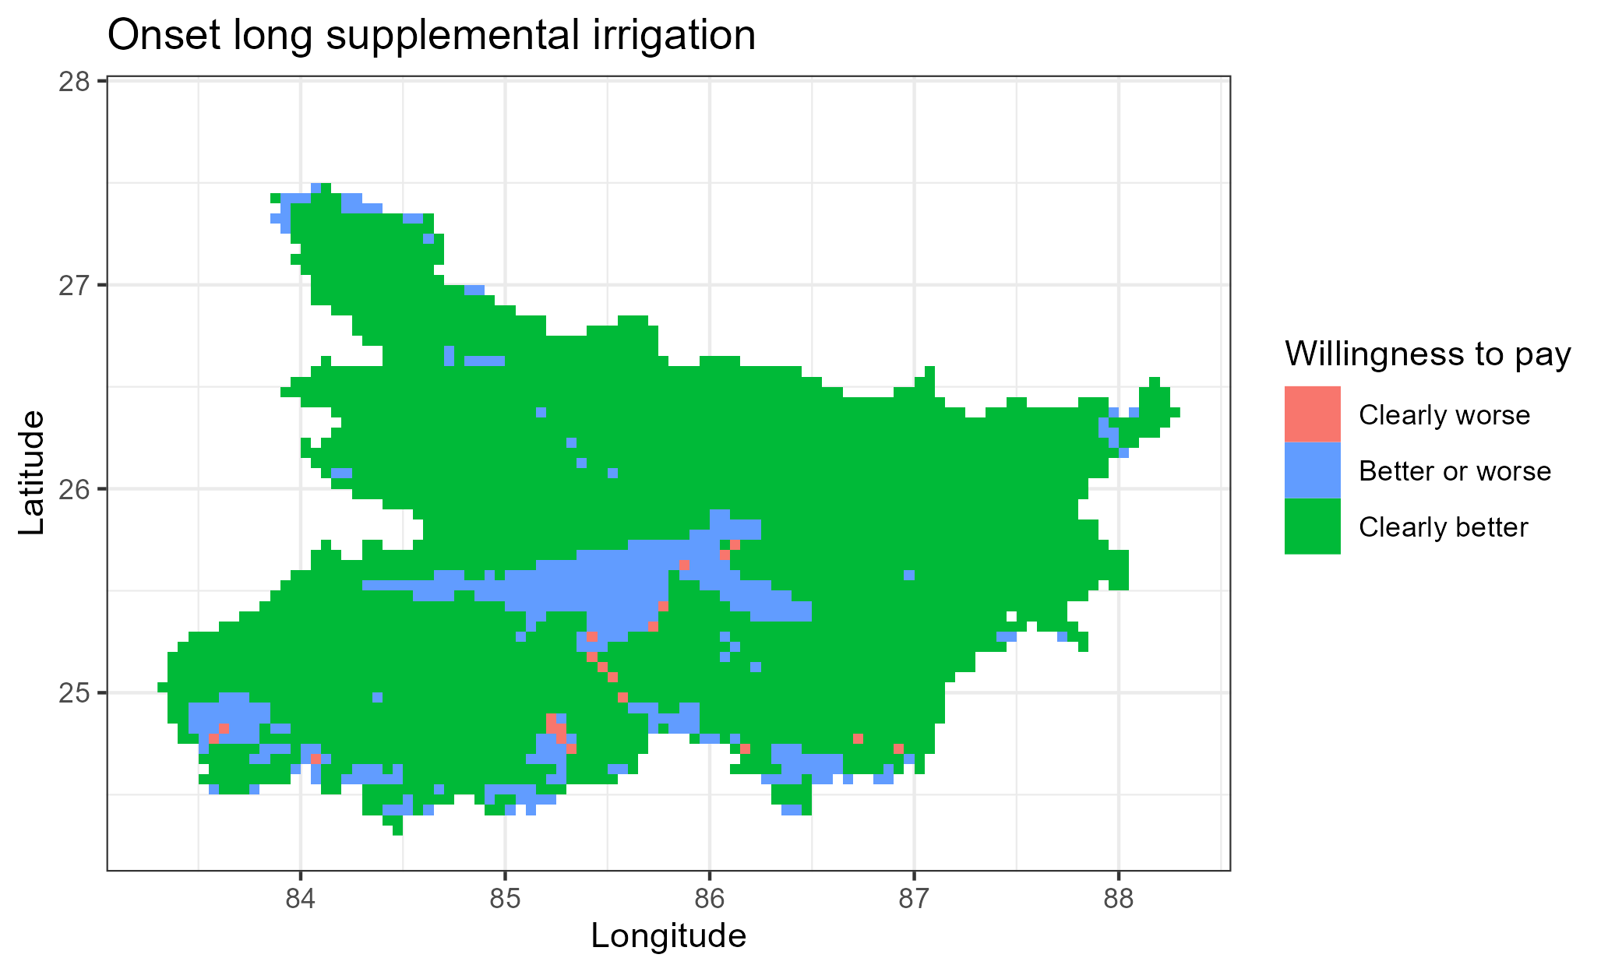
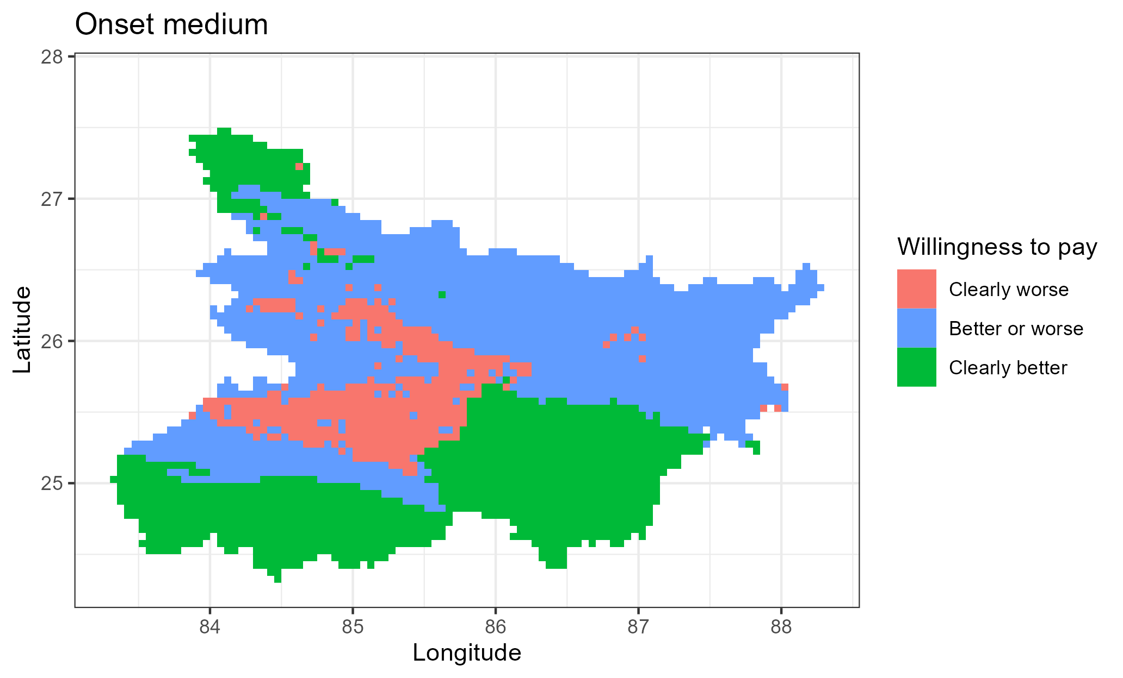
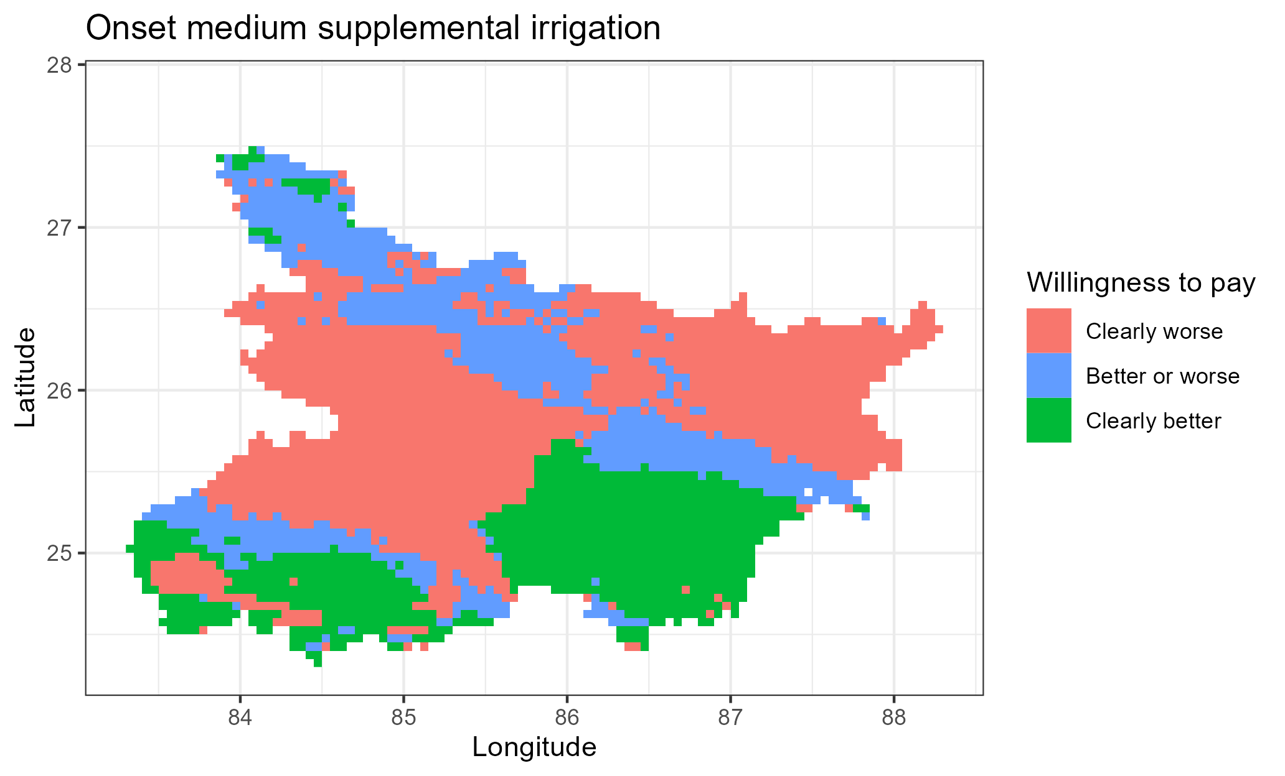

Slide 19
Conclusion

Slide 20
Appendices

